Slide 1


What is an animal made up of ?
Basic components of an animal
Chapter 2. From Molecules to Cells;
Chapter 3. Embryonic Development;
Chapter 4. Tissues, Organs, and Organ Systems

Slide 2
Chapter 2. From Molecules to Cells
Section 1. Chemical Composition and
Main Macromolecules of a Cell
Concept: What are cells?
Cells are the basic organizational units of life

Slide 3
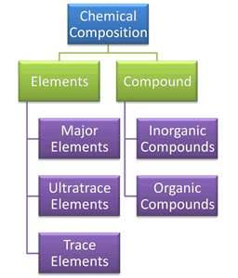
2. Chemical Composition of a Cell
Elements: C, H, N, O (96%);
P, S, Ca (3.35%);
Fe, Mn, Cu, Zn
Compounds: Carbohydrate,
Protein, DNA,
RNA, Lipid;
Mineral salt,
Water

Slide 4
3. Biomolecules in a Cell
Small Molecules | Macromolecules | Macromolecule Complex
Monosaccharide | Polysaccharides | Glycoprotein
Amino acid | Protein | Glycolipid糖脂
Nucleotide | DNA or RNA | Lipoprotein
Lipid
Vitamine
Water
Mineral salt

Slide 5
4. Cell Types
Prokaryotic Cell
Eukaryotic Cell
1) Plant Cell
2) Animal Cell

Slide 6
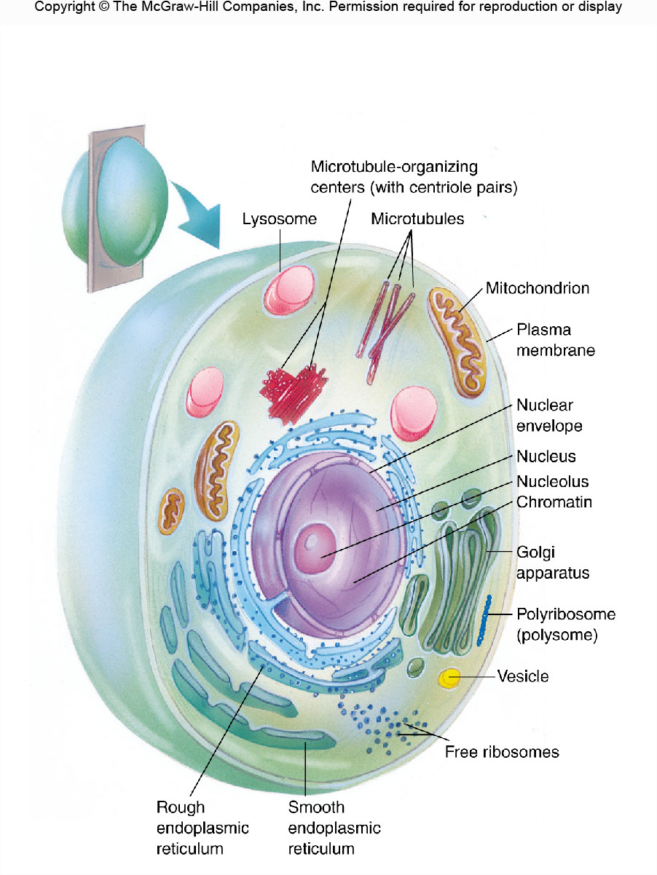
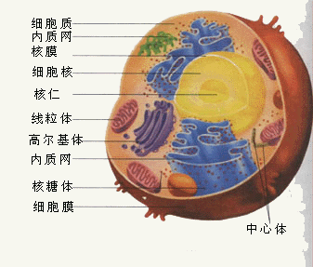
Cytoplasm
A typical animal cell

Slide 7
Comparison of Prokaryotic and Eukaryotic Cells
Component | Prokaryote | Eukaryote
Organization of genetic material
Nucleus, Nucleolus | × | √
No. of Chromosomes | 1 | >1
DNA with Histones | × | √
Mitosis occurs | × | √
Genetic Recombination | Partial | Meiosis
Mitochondria | × | √
Chloroplasts | × | √
Plasma Membrane | Usually No | Yes
Flagella鞭毛 | One fiber | >1 fiber
Endoplasmic Reticulum | × | √
Component | Prokaryote | Eukaryote
Simpler Organelles
Ribosomes | 70S | 80S
Lysosomes | 1 | >1
Microtubules | × | √
Cytoskeleton | × | √
Vacuoles | √ | √
Vesicles | √ | √
Differentiation | Rudimentary | Tissues
Golgi Apparatus | × | √
Cell Walls | Complex | Simpler
Prokaryote: no nucleus/nucleolus/nuclear envelope/classic organelles (simpler, less info)
Eukaryote: nucleus/nucleolus/nuclear envelope/classic organelles (complex)

Slide 8
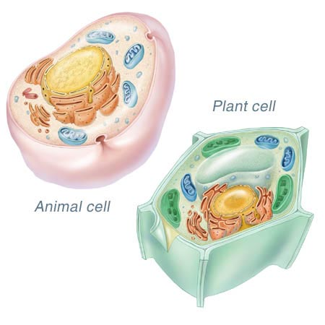
Comparison of Plant and Animal Cells
Animal cells possess
lysosomes uniquely
Plant cells possess
cell wall and chloroplasts

Slide 9
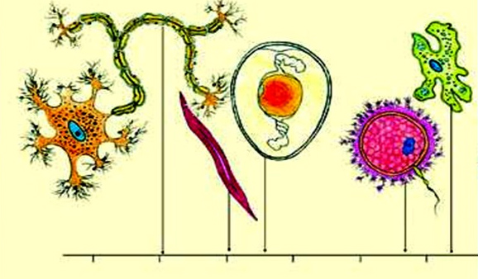
5. The morphology of cells
Diverse morphology of cells shapes differential functions

Slide 10
Section 2. Basic Structure of an Animal Cell
1. Biological Membrane System 生物膜系统
2. Genetic Information Center 遗传信息表达系统
3. Cytoskeleton System 细胞骨架系统

Slide 11
1. Biological Membrane System
1.1 Cell Membrane or Plasma Membrane 质膜
1.2 Nuclear Envelope 核膜
1.3 Organelles 细胞器
1) Endoplasmic Reticulum, ER 内质网
2) Golgi Apparatus 高尔基体
3) Lysosome 溶酶体
4) Mitochondrion 线粒体

Slide 12
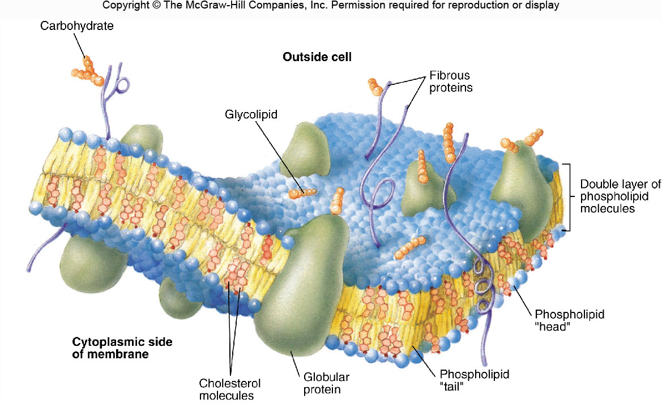
1.1 Cell Membrane
Fluid-Mosaic Model of Membrane Structure
Function: Selective exchange, energy conversion, identification, signal transduction

Slide 13
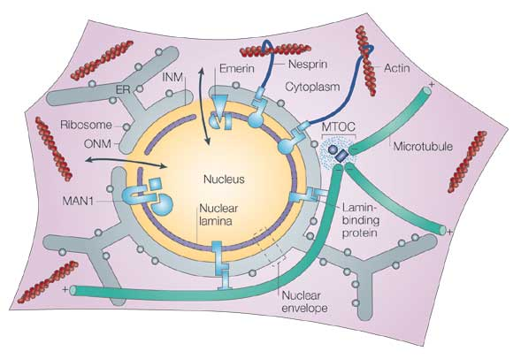
1.2 Nuclear Envelope
Function: Separating the nucleus, genetic material and nuclear activity from
outside intrusions, this helps preserve the genetic integrity of the cell
(protecting DNA)

Slide 14
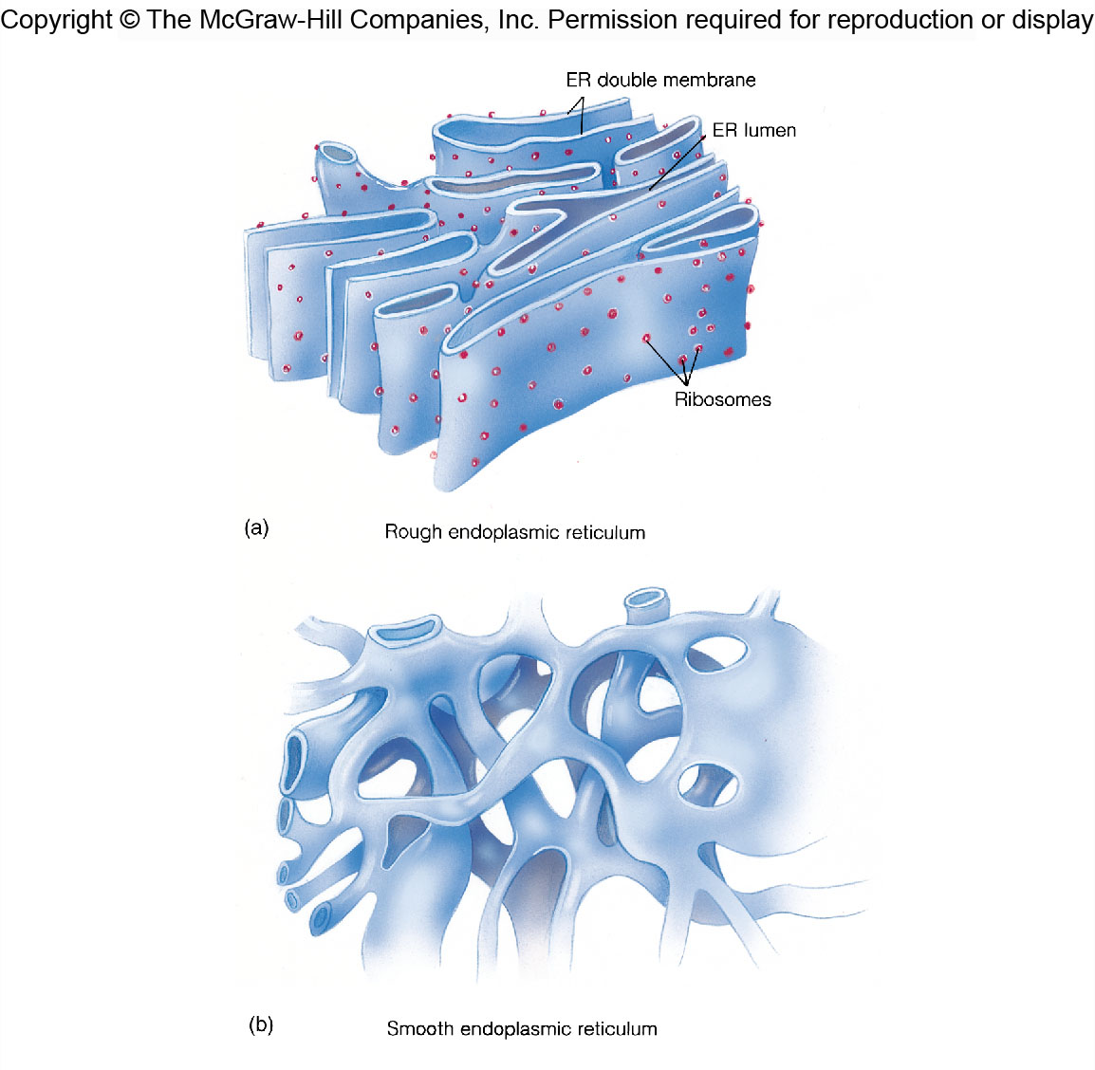
1.3 Organelles
ER w/ ribosomes:
Production and transport
of proteins, because
ribosomes are protein
workbenches
ER w/o ribosomes:
Lipid production,
detoxification
ER: Production and
transport

Slide 15
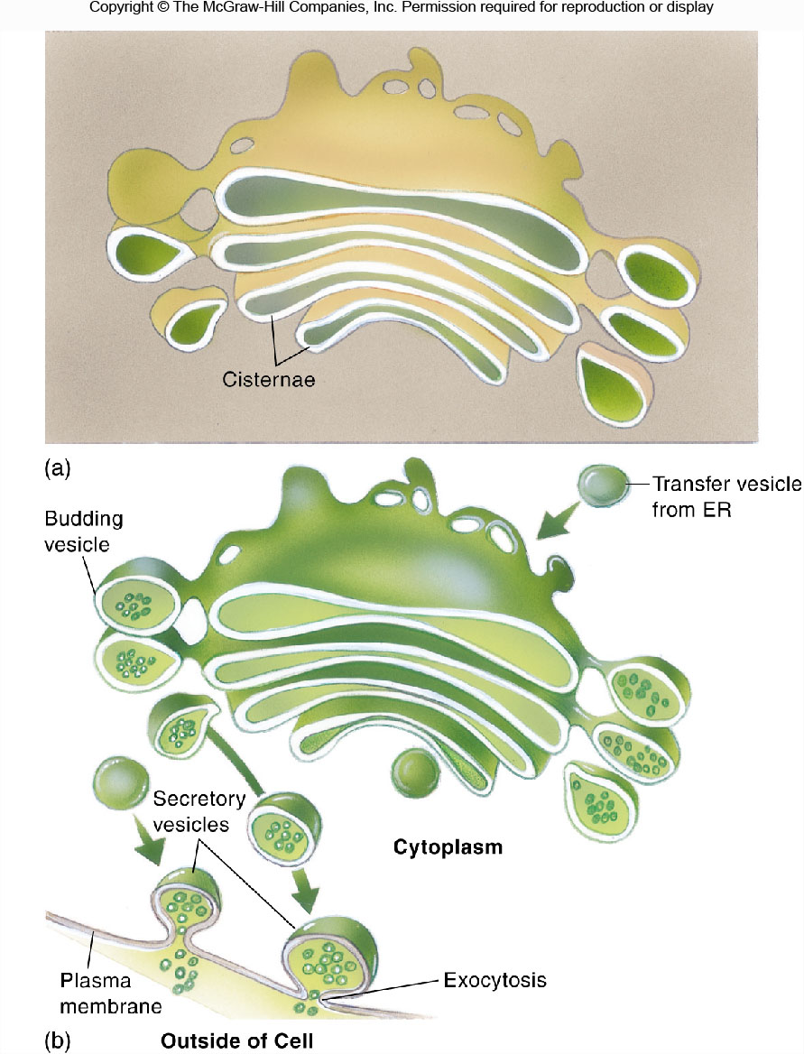
1.3 Organelles
ER w/ ribosomes:
Production and transport
of proteins, because
ribosomes are protein
workbenches
ER w/o ribosomes:
Lipid production,
detoxification
ER: Production and
transport

Slide 16
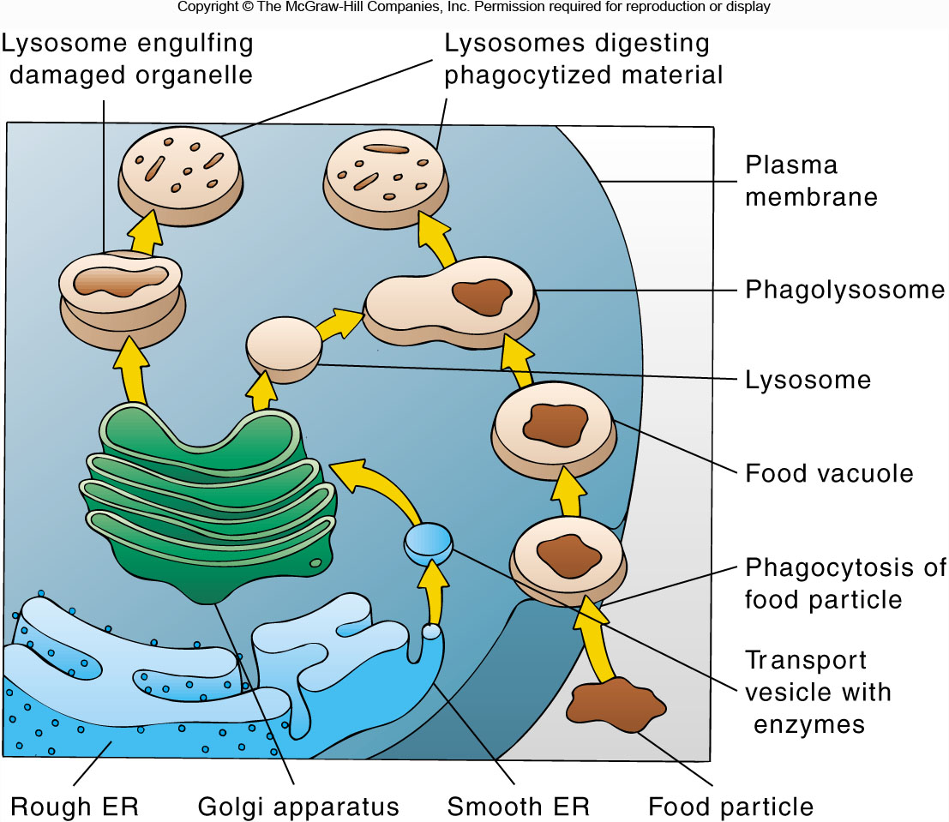

Slide 17
